Slide 1
Overview
Basic Informix Server Monitoring
Informix Command Utilities
Monitor Informix Server Operations
Mode of Server
Show Operation System Info
Show Informix Instance
Show ONCONFIG File

Slide 2
Basic Informix Server Monitoring
• Onstat – Discovery Options
• Onstat – Performance Ratios
• Onstat – User Sessions and Threads
• Onstat – Measuring Disk IO
• Onstat – Monitoring Locks
• Other Onstat Options
• Oncheck – Basic Dbspace Checks
• Omode – How to Terminate a Session

Slide 3
Informix Command Utilities
• ONSTAT - Shows shared memory and server statistics
• ONCHECK - Checks and repairs disk space
• ONMODE - Changes Server's operating mode and terminates User Session

Slide 4
Onstat – Monitor Informix Server Operations
• Onstat utility reads shared-memory structures and provides statistics about the database server at the time that the command executes.
• The contents of shared memory might change as the onstat output displays.
• The onstat utility does not place any locks on shared memory, so running the utility does not affect performance.
• Onstat is a key utility to monitor the performance of your Informix server.

Slide 5
Discover Your Informix Server
Onstat Option | Purpose
onstat - | Show version, status, and uptime of the server
onstat –g osi | Show operation system and machine info
onstat –g dis | Show known Informix servers on machine
onstat -c | Show server configuration ONCONFIG File
onstat -d | Show Informix dbspaces and chunks
onstat -l | Show logical logs status
onstat –m | Show Informix server message log
onstat -g sch | Show Informix oninit processes and classes
onstat –g seg | seg Show Informix memory segments

Slide 6

Onstat – Monitor Informix Server Operations
Instance Online
Instance Down

Slide 7
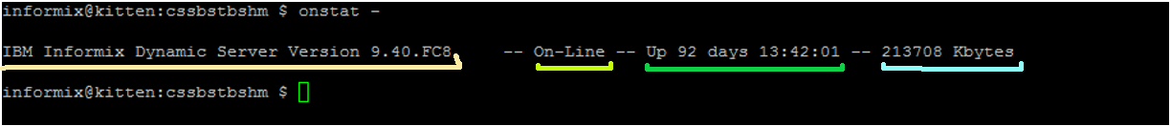
Onstat Header Information
Product and Version
Mode (and Type)
(Optional: Reason when Server is Blocked)
Time Server has been up
Size of Shared Memory in Kbytes

Slide 8
Mode of Server
Off-Line Mode (does not show in header)
Quiescent Mode (Admin Mode)
On-Line Mode
Read-Only Mode (DR Only)
Recovery Mode
Shutdown Mode

Slide 9
Reason when Server is blocked
CKPTREQ - Checkpoint
LONGTX - Long transaction
ARCHIVE - Ongoing storage-space backup
MEDIA_FAILURE - Media failure
HANG_SYSTEM - Database server failure
DBS_DROP - Dropping a dbspace
DDR - Discrete data replication (Informix)
LBU - Logs full high-watermark

Slide 10
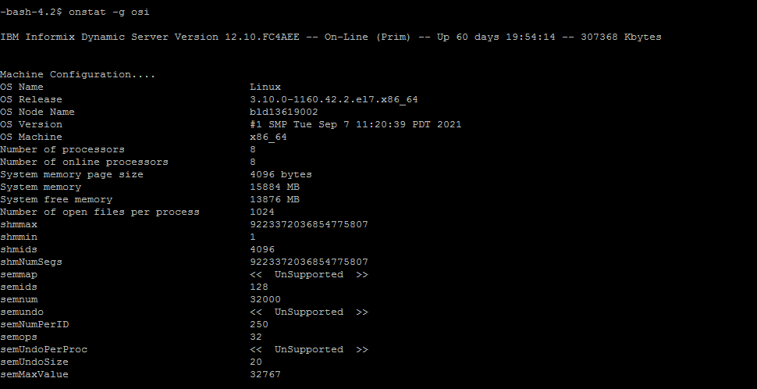
Onstat –g osi : Show Operation System Info

Slide 11
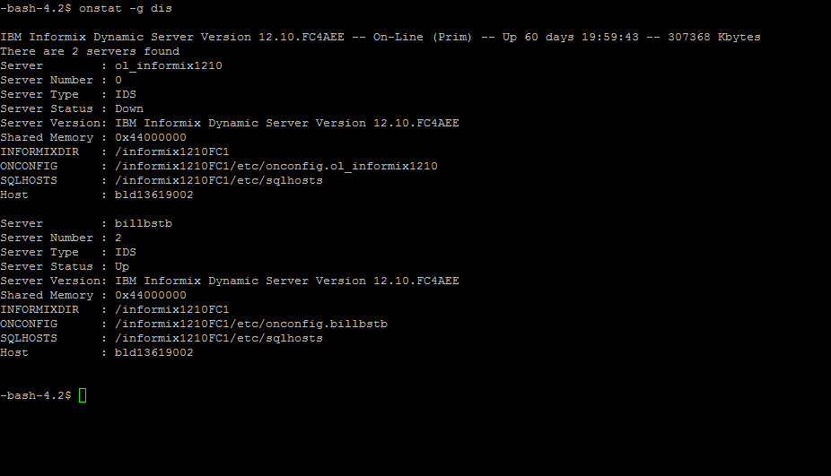
Onstat –g dis: Show Informix Instance

Slide 12
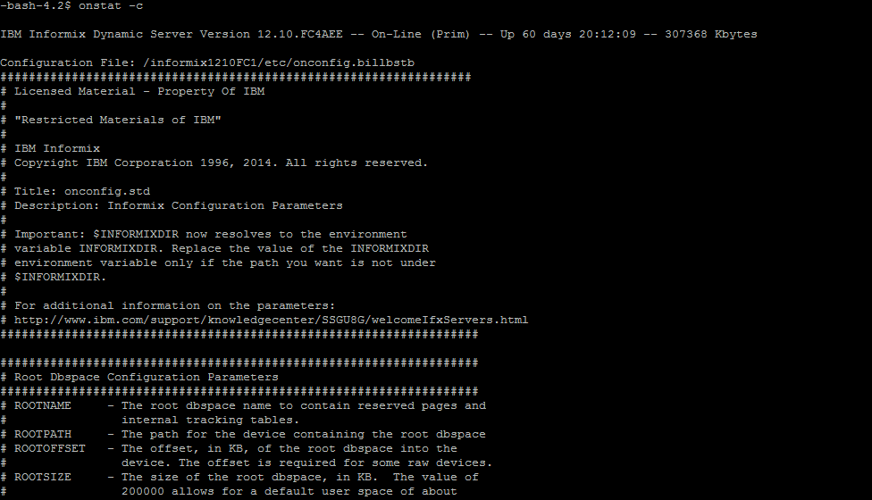
Onstat –c: Show ONCONFIG File

Slide 13
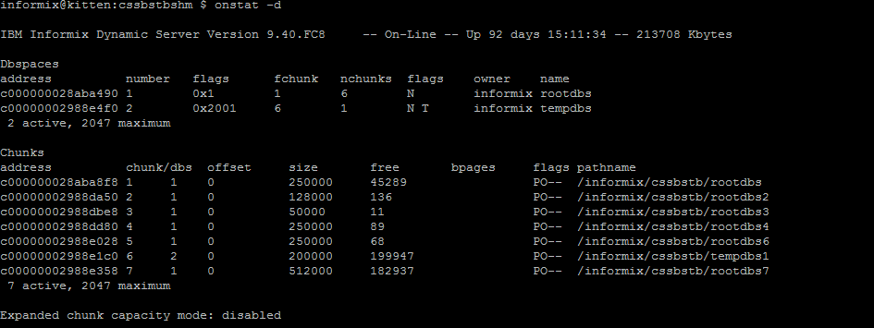
Onstat –d: Show DBSpaces and Chunks

Slide 14
Onstat -d Flags
The "flags" for Dbspaces are:
Position 1
M - Mirrored Dbspace
N - Not Mirrored Dbspace
Position 2
X - Newly mirrored
P - Physical recovery underway
L - Logical recovery underway
R - Recovery underway
D - Down
Position 3
B – Blobspace
P – Plogdbs
S – Sbspace
T – Temporary Dbspace
U – Temporary SBSpace
W – Temporary Dbspace on SD Server
Position 4
B – Chunk greater than 2GB Enabled
Position 5
A = Auto expandable
Position 6
E - Encrypted
The "flags" for Chunks are:
Position 1
P - Primary
M - Mirror
Position 2
O - On-line
D - Down
X - Newly mirrored
I - Inconsistent
N – Renamed and Down or Inconsistent
Position 3
B - Blobspace Dbspace
T - Temporary Dbspace
Position 4
B – Chunk greater than 2GB Enabled
Position 5
E – Chunk is Extendable
Position 6
- Direct IO not enabled
C – AIX Concurrent IO enabled
D – Direct IO Enabled

Slide 15
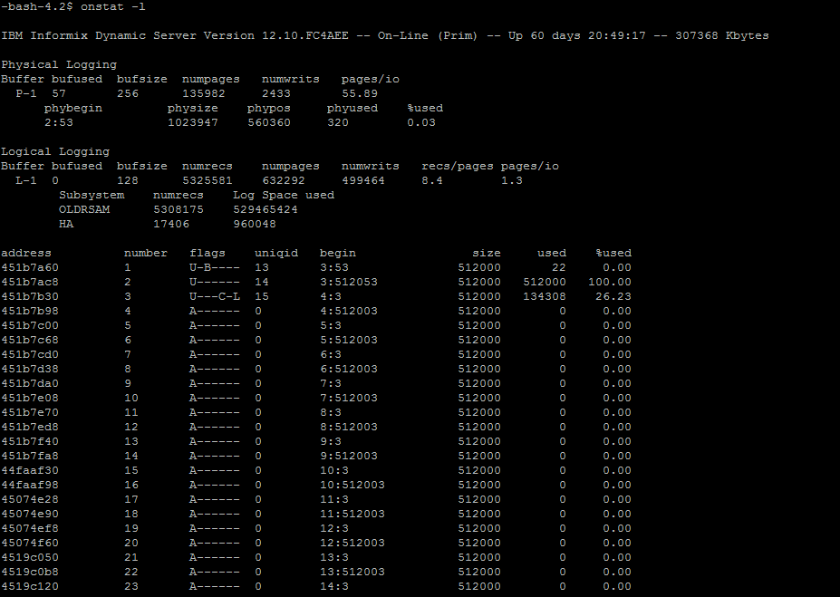
Onstat –l: Show Logs

Slide 16
Onstat -l Flags
A - New and ready to use
B - Backed up
C - Current logical-log file
D - Marked for deletion
F - Free and available for reuse
L - Contains the last checkpoint record
U - Used

Slide 17
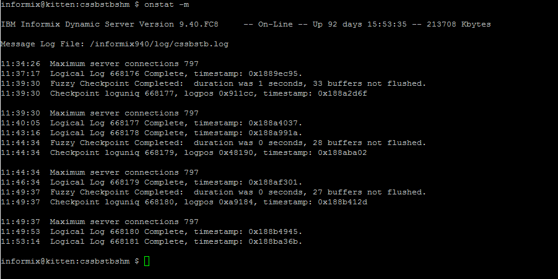
Onstat –m: Show Message Logs

Slide 18
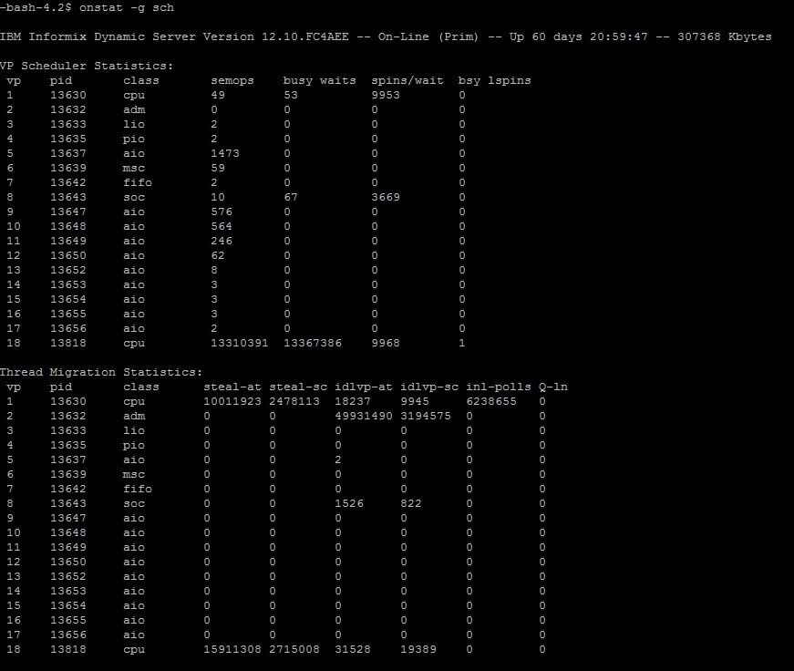
Onstat –g sch: Show Oninit Process and Classes

Slide 19
Oninit Process Classes
CPU - Executes all user and session threads and some system threads
PIO - Handles physical log file when cooked disk space is used
LIO - Handles logical log file when cooked disk space is used
AIO - Handles disk I/O
SHM - Performs shared memory communications
TLI - Performs TLI network communications
SOC - Performs socket network communications
FIFO - Performs FIFO operations
OPT - Handles optical disk I/O
ADM - Executes administrative threads
ADT - Executes auditing threads
MSC - Handles request for system calls

Slide 20
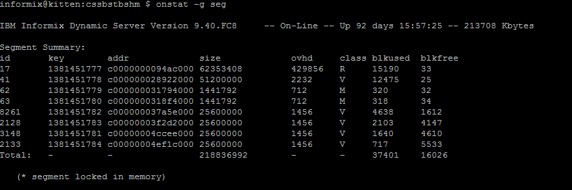
Onstat –g seg: Show Memory Segments

Slide 21
Informix Memory Classes
R – Resident Memory Segment
B – Buffer Pool Segment for data
V – Virtual Memory Segment for Working Storage
M – Message Segment for communications between clients

Slide 22
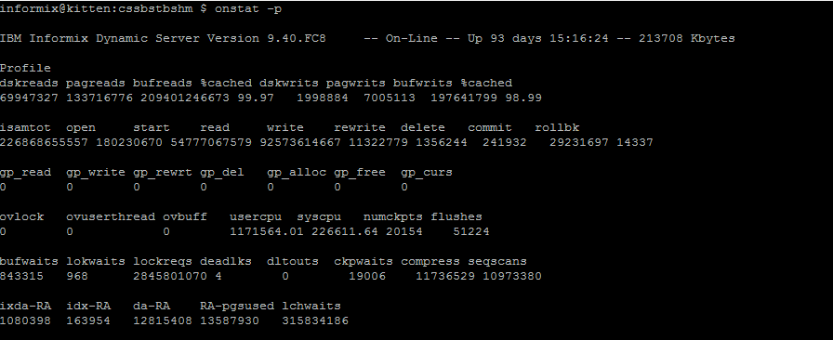

Onstat –p: Server Profile Performance Ratios
Disk I/O
Action
CPU
Waits
Read Ahead
Onstat –z – FOR FRESH DATA

Slide 23
Key Elements of onstat -p
Reads %cached - The goal is > 95%
Writes %cached - The goal is > 85%
The BUFFERS parameter in your ONCONFIG file will affect this value.
Be careful - if you make the BUFFERS too large this will take memory away from other processes and may slow down your whole system.
bufwaits - This indicates the number of times a user thread has waited for a BUFFER.
lokwaits - This indicates the number of times a user thread has waited for a LOCK.
deadlks - This should be zero. This indicates the number of times a deadlock was detected and prevented.
dltouts - This should be zero. This indicates the number of times a distributed deadlock was detected.

Slide 24
User Sessions and Threads
Onstat Options | Purpose
Onstat –u | Show User Sessions Status
Onstat –x | Show User Sessions Transactions
Onstat –g sql | Show Sessions and SQL
Onstat –g ses | Show Session Details

Slide 25
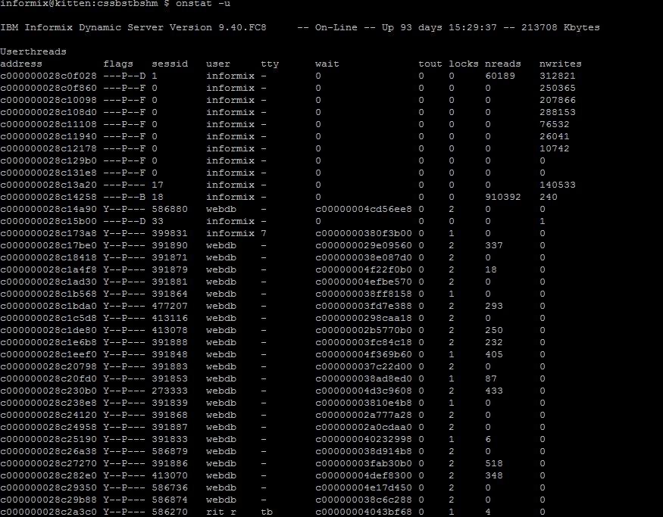
Onstat –u: User Status

Slide 26
User status: onstat -u Flags
Flags in position 1
B - Waiting on a buffer
C - Waiting on a checkpoint
G - Waiting on a logical log buffer write
L - Waiting on a lock
S - Waiting on a mutex
T - Waiting on a transaction
Y - Waiting on a condition
X - Waiting on a transaction rollback
Flags in position 2
* - Transaction active during I/O error
Flags in position 3
A - Dbspace backup thread
B - Begin work
P - Prepared for commit work
X - TP/XA prepared for commit work
C - Committing work
R - Rolling back work
H - Heuristically rolling back work
Flags in position 4
P - Primary thread for a session
Flags in position 5
R - Reading call
X - Transaction is committing
Flags in position 6
None
Flags in position 7
B - Btree cleaner thread
C - Cleanup of terminated user
D - Daemon thread
F - Page flusher thread
M - ON-Monitor user thread

Slide 27
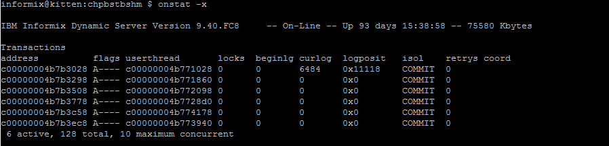
Onstat –x: Show Transactions
Begin Transaction
Current Transaction
users

Slide 28
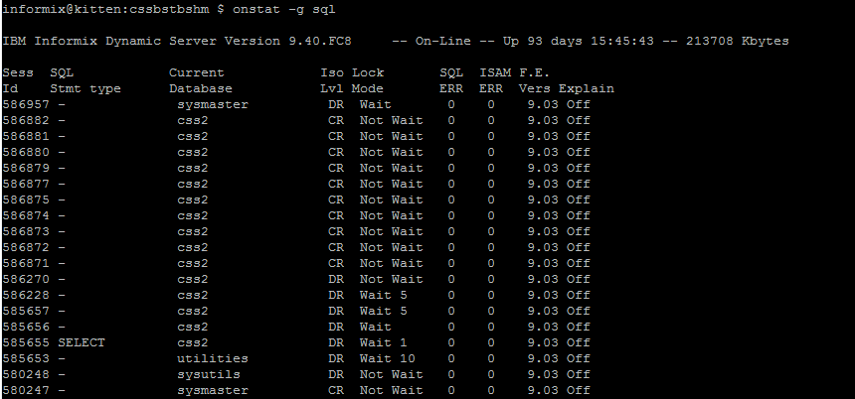
Onstat –g sql: List SQL statements

Slide 29
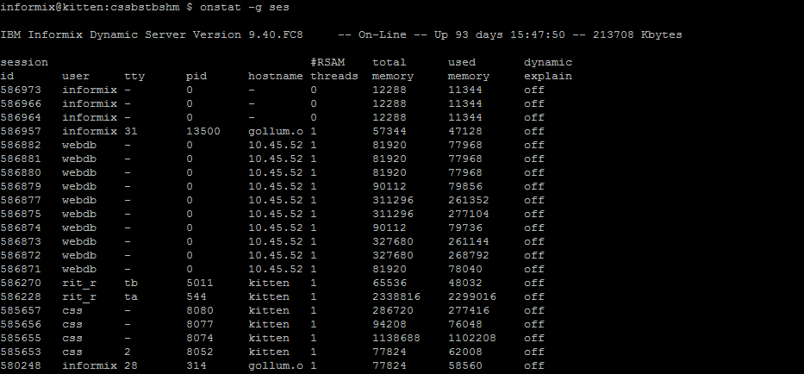
Onstat –g ses: List current SQL Session

Slide 30
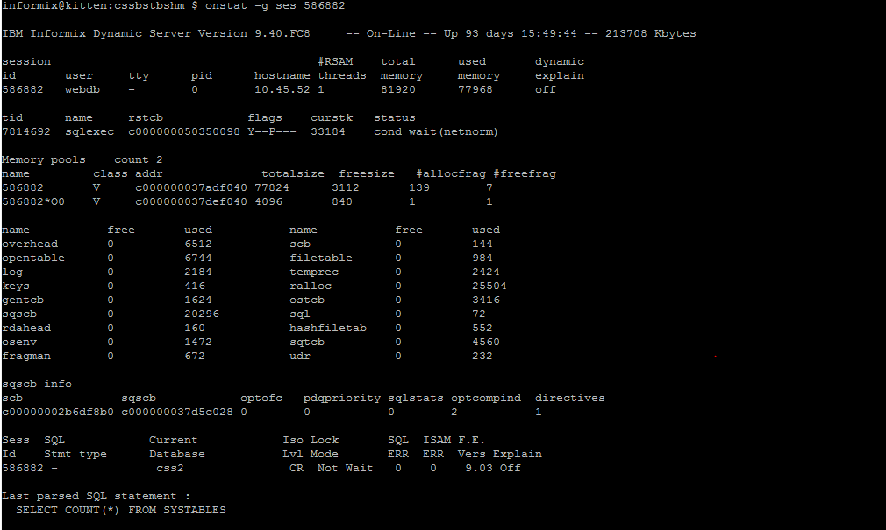
Onstat –g ses: current SQL Session

Slide 31
Onstat - Show Threads
Onstat Option | Purpose
onstat -g ath | Show all threads
onstat -g rea | Show threads ready to run
onstat -g wai | Show threads waiting to run
onstat -g act | Show active threads running
onstat -g bth | Show blocking threads

Slide 32
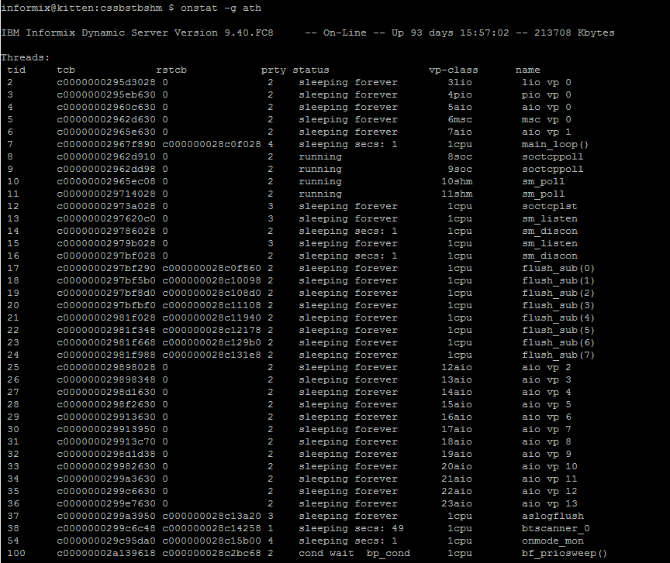
Onstat –g ath: Show threads

Slide 33
Onstat – Show Disk IO
onstat -D | Show Dbspaces and Chunk IO Statics
onstat -g iof | Show Disk IO Statistics by Chunk/file
onstat –g iov | Show Disk IO Statistics by Oninit VP
onstat –g ioh | Show Disk IO History
onstat –g ckp | Show Checkpoint Statistics
onstat -F | Show Buffer Flush Statistics
onstat -R | Show LRU Queue Statistics

Slide 34
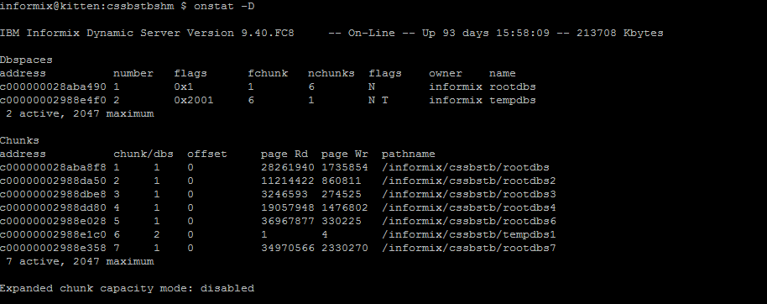
Onstat –D: Disk IO

Slide 35
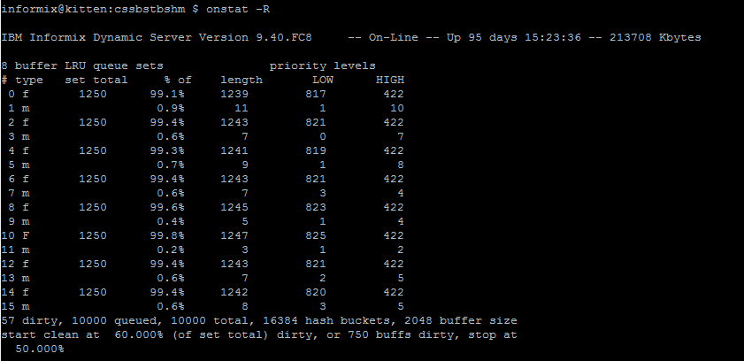
Onstat –R: LRU Statistics

Slide 36
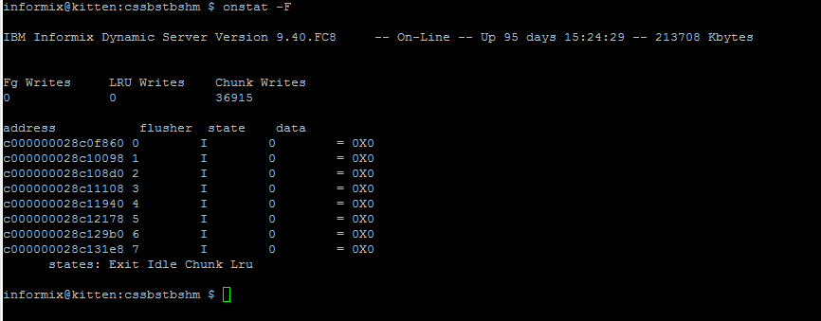

Onstat –F: Flush to Disk

Slide 37
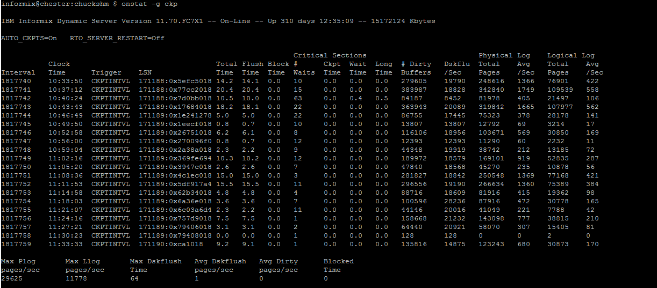
Onstat –g ckp: Show Checkpoint History

Slide 38
LOCKS
Onstat –k to Show Locks
How many Lock Table overflows?
What User Owns the Lock?
What Table is Locked?
What Type of Lock is it?

Slide 39
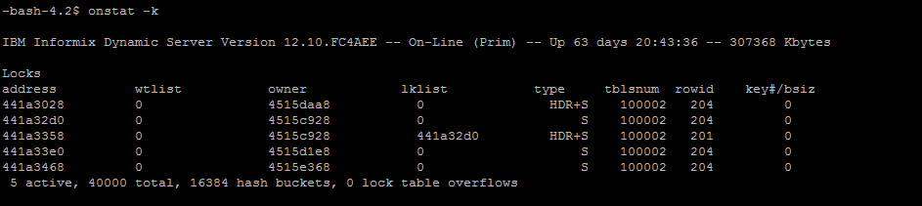
Onstat –k: Show Locks
WARNING: If you have a large number of LOCKS defined in your ONCONFIG
file and many users, you could see thousands of rows from this command.

Slide 40
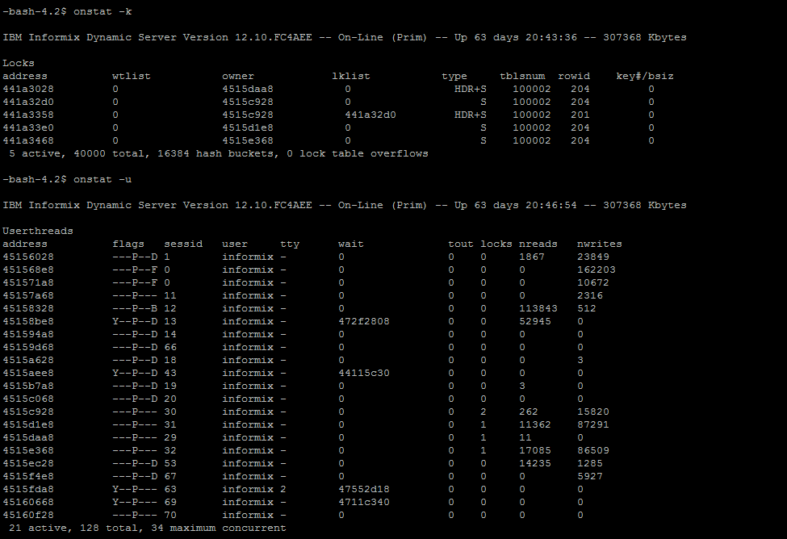
Who owns a lock
The "owner" column lists the address in shared memory of the user who owns a lock. Use this with "onstat -u" to see all users and compare this with the "address" column to identify username of the owner.

Slide 41
What table is locked?
The "tblsnum" column identifies the table that is being locked. Compare this with the output of the following SQL statement to convert a table's partnum to hex. This will identify which table is locked.

Slide 42
Types of locks
Database - Lock on tablespace 100002
Table - Lock on actual tablespace with rowid of 0
Page - Lock on tablespace with rowid ending in 00
Row - Lock on tablespace with actual rowid (not 00)
Byte - Lock on tablespace/page with size of bytes
Key - Lock on tablespace hex rowid (starting with f)

Slide 43
Types of locks Flags
HDR - Header
B - Bytes lock
S - Shared lock
X - Exclusive
I - Intent
U - Update
IX - Intent-exclusive
IS - Intent-shared
SIX - Shared, Intent-exclusive

Slide 44
More Onstat Options
Onstat –r | Repeat every <seconds> seconds (default: 5)
Onstat -z | Zero profile counts (To flush the profile counts)
Onstat -o | Put shared memory into specified dump file
onstat <infile> | Read shared memory information from specified dump file
onstat -i | Interactive mode

Slide 45
Onstat –r: Repeat
Repeat ONSTAT commands: -r
To continually repeat an ONSTAT command use the "-r # of seconds" option. This is very useful when you need to monitor a situation. The following example displays the status of the logical logs every 10 seconds.
onstat -l -r 10

Slide 46
Onstat –z: Reset Statistics
Clear ONSTAT shared memory statistics: onstat -z
• The Server statistics are reset every time OnLine is restarted. To reset all the statistics while OnLine is running without shutting it down, use the following command:
onstat -z

